Slide 1
Microsoft ASP.NET Performance Engineering
Joseph Antoney Moyesan Thomas Kingslin
11/30/2016

Slide 2
Agenda
Part-I: “make it work” vs “make it perform”
Application Performance
Asynchronous
.NET Framework 4 and TAP
.NET Framework 4.5 async await
MVC async await
Part-II: The Sweet Switch

Slide 3
Part-I “make it work” vs “make it perform”

Slide 4
Application Performance should be built-in and should not be afterthought.
If data is worth caching then cache the data to avoid trip to DB server
Session State – InProc / State / SQL Server based on Single Server or Web farm. (also Distributed Caching using Redis Cache)
Partition application into presentation, business and data access
Avoid blocking by asynchronous mechanism
Resource Management
Resource Pooling – ADO.NET supports default pooling
@outputcache static contents
HTTP modules allow to add preprocessing and post processing of request

Slide 5
asynchronous
.NET framework maintains pool of threads and dispatch one thread per request to server.
.NET framework 4.5 max. thread pool is 5000
Each new thread has overhead of adding 1MB of stack mem.
On peak concurrency with synchronous program with high latency 5000 thread consume ~5GB of mem. In this scenario asynchronous program consumes only 50 threads.
By default, we need to increase the HTTP.sys queue limit from 1,000 to 5,000 in IIS Advanced Settings.
If application uses System.Net for web service communication then we can increase max connection to 12 times the no. of CPU during app initialization (System.Net.ServicePointManager.DefaultConnectionLimit = 24;)

Slide 6
.NET Framework 4 way: TAP Task based Asynchronous Programming
{
Task t1 = Task.Factory.StartNew(() => function1(input,httpContext));
Task t2 = Task.Factory.StartNew(() => function2(input,httpContext));
bool taskStatus;
try
{
List<Task> listofTasks= new List<Task>{t1, t2};
taskStatus = Task.WaitAll(listofTasks.ToArray(),interval);
}
Catch(AggregateException exception)
{
//log exception.InnerExceptions
If(t1.IsFaulted)
{}
If(t2.IsFaulted)
{}
}
If(taskStatus == false)
{
//access t1.IsCompleted prop to check task status
}
}

Slide 7
.NET Framework 4.5 way: async await
public void Page_Load(object sender, EventArgs e)
{
RegisterAsyncTask(new PageAsyncTask(LoadSomeData));
}
private async Task LoadSomeData()
{
var gizmoService = new GizmoService();
var gizmoList = await gizmoService.GetGizmosAsync();
GizmosGridView.DataSource = gizmoList;
GizmosGridView.DataBind();
}
public async Task<List<Gizmo>> GetGizmosAsync()
{
var uri = Util.getServiceUri("Gizmos");
using (HttpClient httpClient = new HttpClient())
{
var response = await httpClient.GetAsync(uri);
return (await response.Content.ReadAsAsync<List<Gizmo>>());
}
}

Slide 8
MVC way: async await
public async Task<ActionResult> PWGasync()
{
ViewBag.SyncType = "Asynchronous";
var widgetService = new WidgetService();
var prodService = new ProductService();
var gizmoService = new GizmoService();
var widgetTask = widgetService.GetWidgetsAsync();
var prodTask = prodService.GetProductsAsync();
var gizmoTask = gizmoService.GetGizmosAsync();
await Task.WhenAll(widgetTask, prodTask, gizmoTask);
var pwgVM = new ProdGizWidgetVM(
widgetTask.Result,
prodTask.Result,
gizmoTask.Result
);
return View("PWG", pwgVM);
}

Slide 9


Part-II
“The Sweet Switch – Tier B applications”

Slide 10
Problem Definition
Migrate old Knowledge Base application to new platform.
As Microsoft SQL Server 2005 reached end of support upgrade database to a modern platform to be compliance.
Upgrade web app stack to latest platform to serve agent much faster.
Build powerful search engine with predictions
Saving few seconds of an agent serving a customer can be multiplied to thousands of dollars saving in a month.
Make the application cloud-ready.
Proposed Solution
MEAN Stack
Elasticsearch
AWS

Slide 11
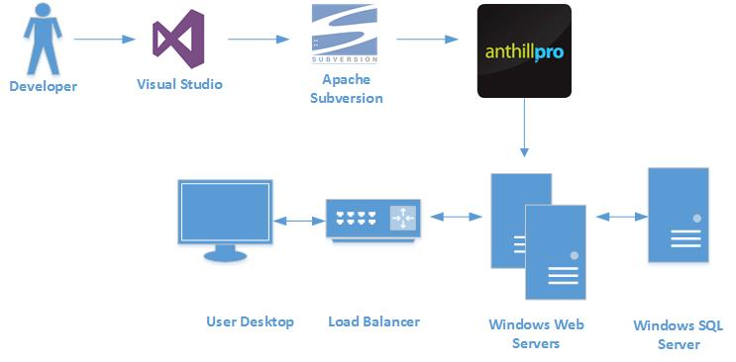
Current Architecture

Slide 12
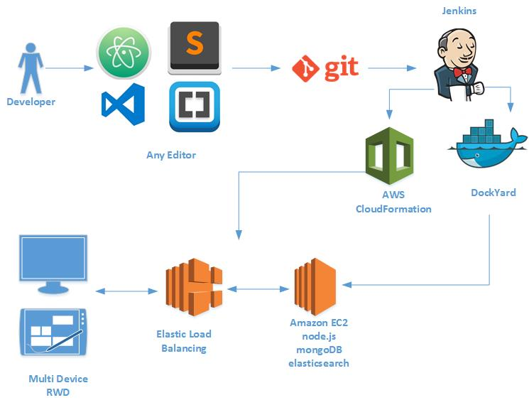
Proposed Architecture

Slide 13
Summary
ASP.NET asynchronous programming and IIS are powerful in handling concurrent web requests.
node.js – JavaScript runtime environment built on Chrome’s V8 engine is much powerful in handling concurrent web requests with event driven, non-blocking I/O model.
A hybrid model with
ASP.NET Core
Kestrel
Angular 2 – Typescript
MongoDB
Linux
Docker
AWS

